Slide 1
Chapter 9: Water
Block 1
Pink Table

Slide 2
Objectives and Vocabulary
Objectives
Relate water’s composition and structure to its properties.
Compare bonds in water.
Explain the functions of heat of fusion and heat of vaporization.
Explain the effect of air pressure changes on boiling point.
Explain sublimation and surface tension.
Explain the functions of water in food preparation.
Describe hard and soft water.
Describe how the body uses water.
Vocabulary
Boiling point
Bound water
Colloidal dispersion
Density
Emulsifier
Emulsion
Free water
Hard water
Heat of fusion
Heat of vaporization
Hydrogen bond
Immiscible
Latent heat
Medium
Melting point
Polar molecule
Solubility
Solute
Solvent
Sublimation
Surface tension

Slide 3
What You Learn
The water molecule
Properties of water
Water and foods
Water and the body

Slide 4
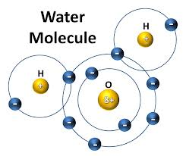
The Water Molecule
Polar covalent bond
Electronegativity
A molecule with a clear division of opposite electrical charges
Hydrogen bonds
Strongly attracts
An attractive force between any molecules in which hydrogen is covalently bound to a highly electronegative element

Slide 5
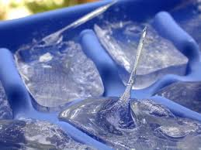
Properties of Water
Water is the medium
A substance through which something is transmitted or carried
Freezing and Melting
Melting point: a temperature that changes a substance from a solid to a liquid
Density: mass
Heat of fusion: energy needed to change one gram of a substance from a solid to a liquid or a liquid to a solid
Latent heat: energy required to cause a phase change without a change in temperature

Slide 6
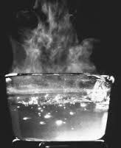
Properties of Water Continued
Boiling and Condensing
Boiling point: temperature when vapor pressure equals air pressure above the liquid
Heat of vaporization: amount of heat needed to change one gram of a substance from a liquid to a gas
Sublimation: a change from the solid phase directly into the gas phase
Surface Tension: an inward force or pull that tends to minimize the surface area of a liquid

Slide 7
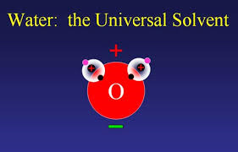
Water and Foods
Water content in food
Free water: readily separates from foods that are sliced, diced, or dried
Bound water: water that cannot be easily separated in food
Water in heat transfer
Water as a solvent
Solvent: substance dissolved in solute
Solubility: amount dissolved at certain temperature
Hard water: water that contains calcium or magnesium ions

Slide 8
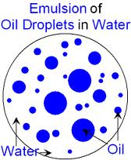
Water and Foods Continued
Water as a dispersing medium
Colloidal dispersion: homogeneous mixture that is not a true solution
Emulsion: liquid droplets that don’t normally blend together
Immiscible: liquids that don’t blend or mix
Emulsifier: large molecules that are polar on one end and nonpolar on the other
Water as an emulsifier: www.youtube.com/watch?v=qcumEy6nhgY

Slide 9
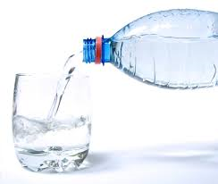
Water and the Body
Water weight
Staying active
Staying hydrated

